Slide 1
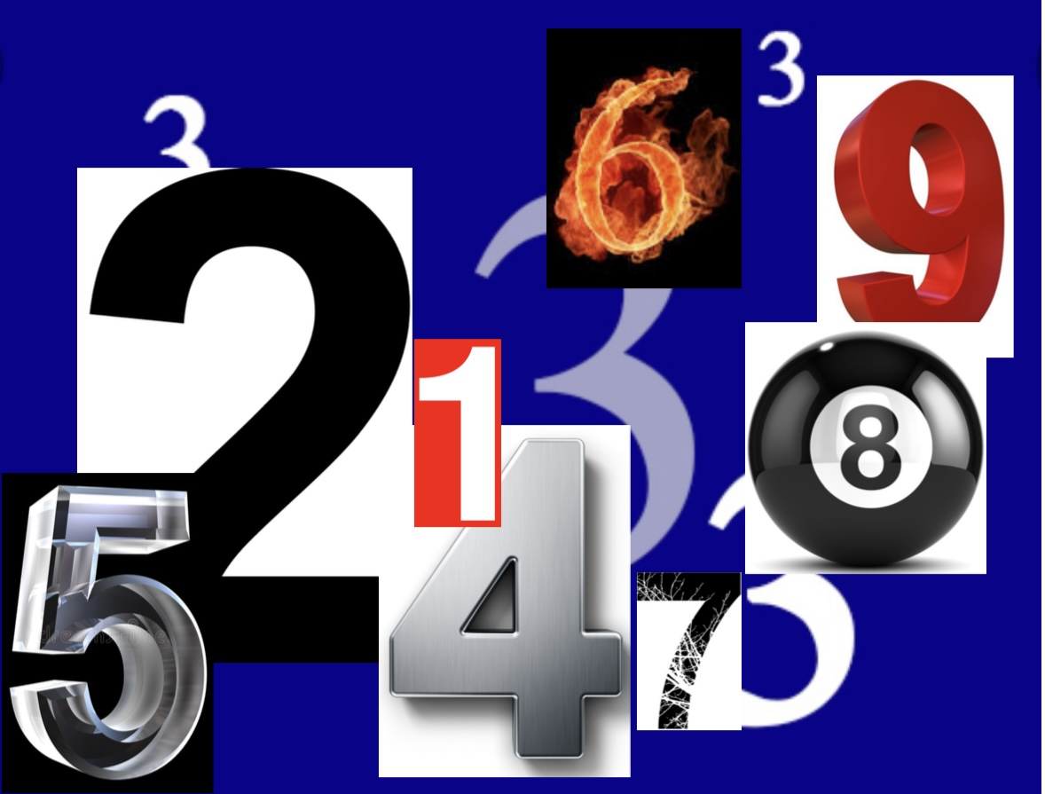
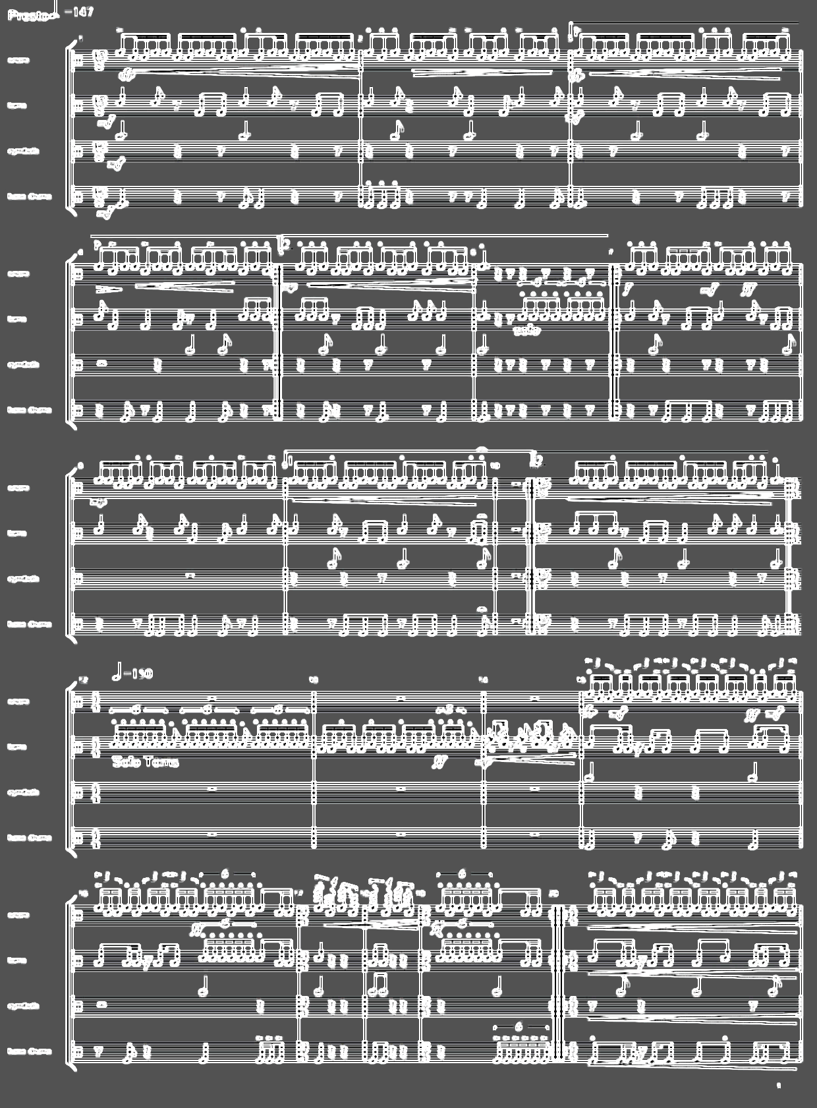
Composition
&
arranging for
Marching Band& Showband style
Open Rudiments
By: Peter Vulperhorst
&
Traditional Collective

Slide 2
Composition
Warming-Up
Razzle-Dazzle
Introduction sections & Players
By: Peter Vulperhorst
&
Traditional Collective

Slide 3
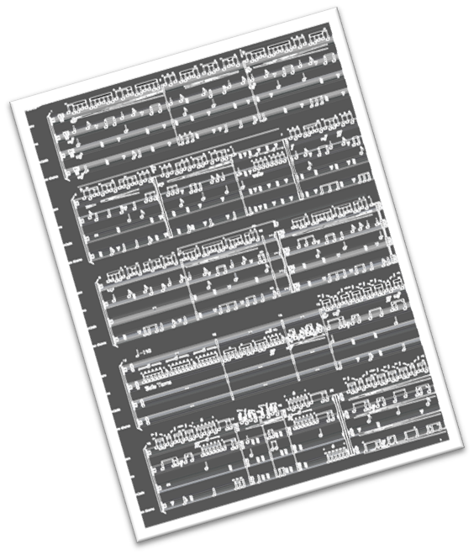
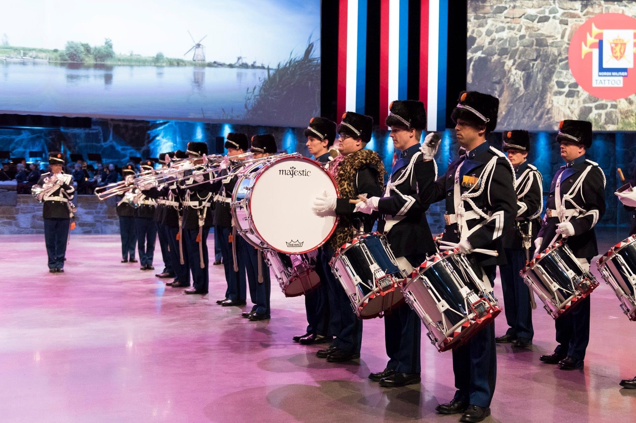
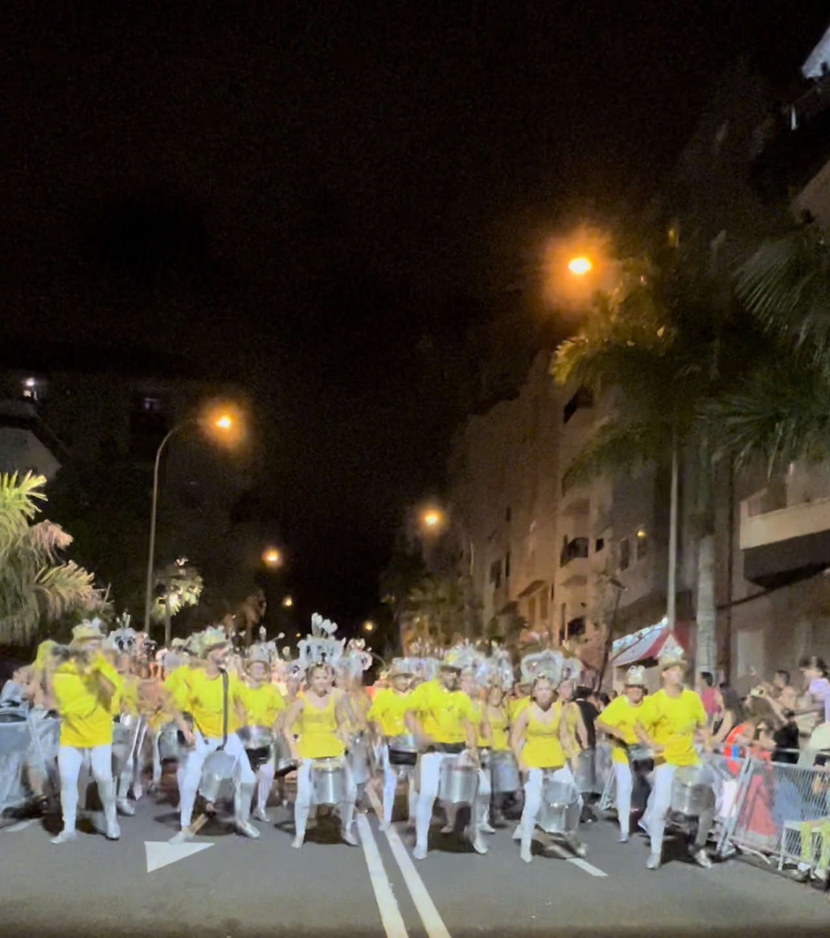
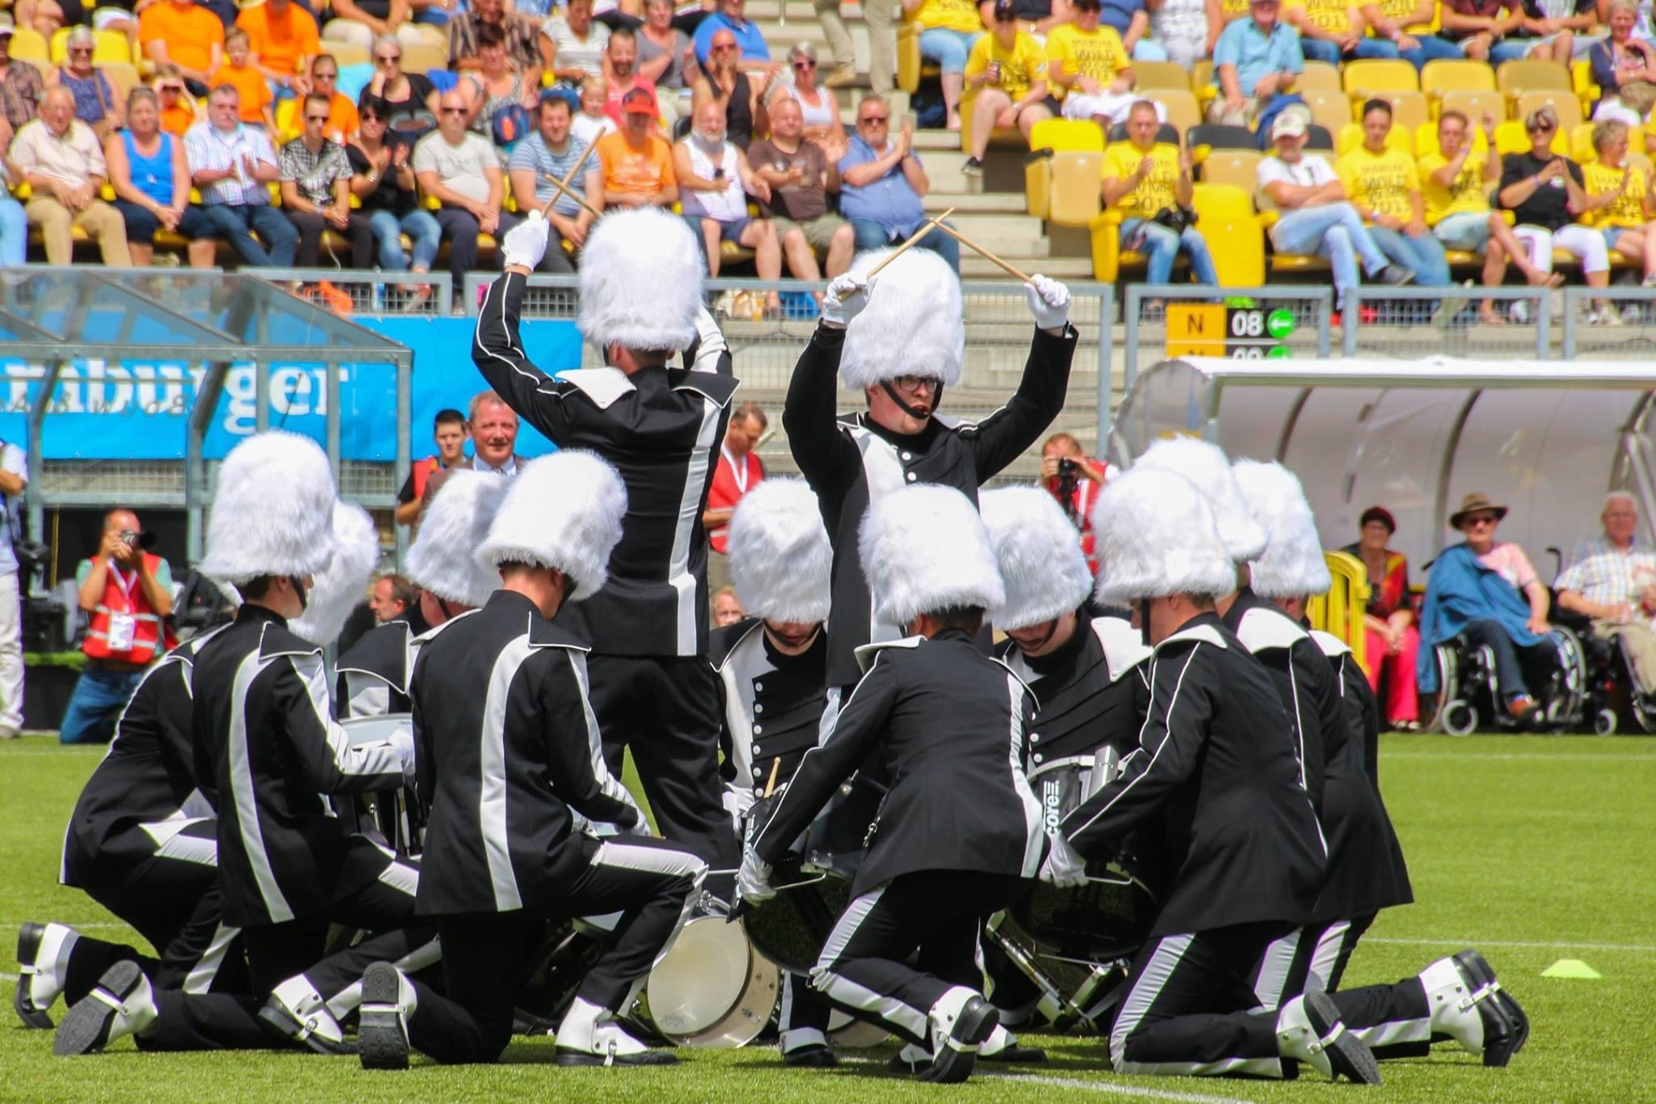
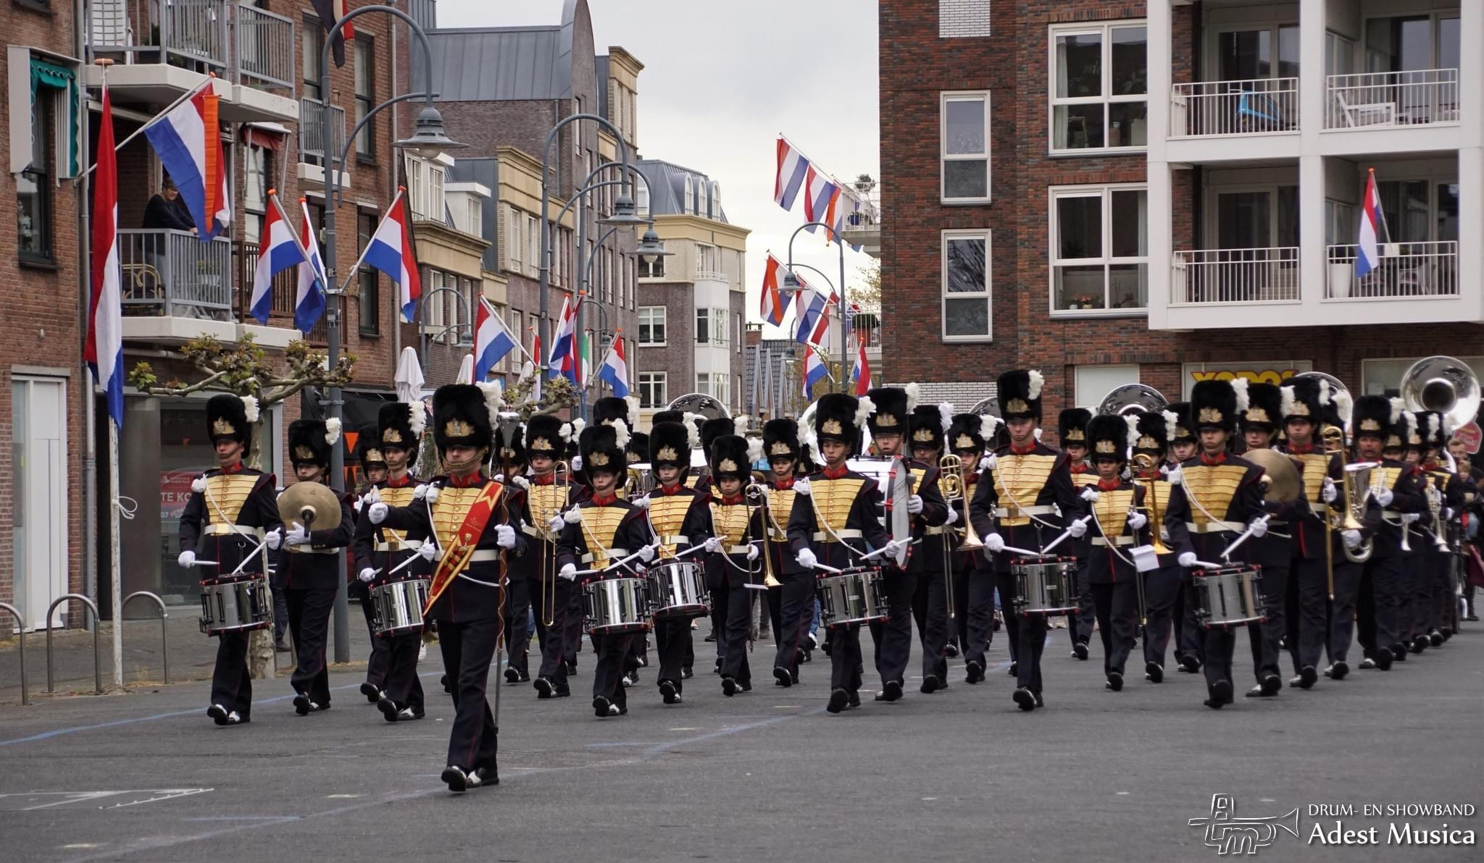
Compositions
What for style?
Tempo 100 -130
Traditional Marching style, what is that?
Ceremonial
Parades
Festivals
Competitions
Tempo +/- 80 --- 200?
Showband style, tipical Dutch!, please explain…
Parades/Carnaval
Festivals ( Stand still or city runs)
Party - Dance ( Projects)
Show - Tattoo (Competition)
2/4-3/4-4/4
2/4-3/4-4/4
3/8-5/8-6/8-7/8-9/8-12/8

Slide 4
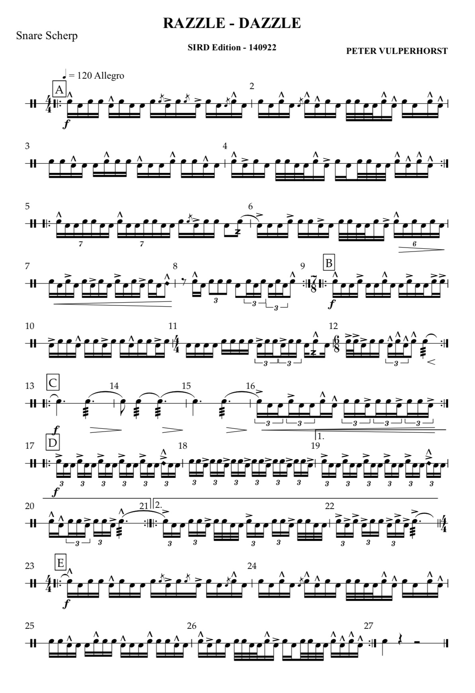
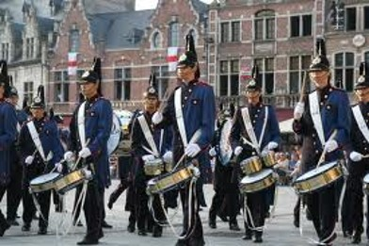
Performance
Razzle Dazzle ( March)
Tempo +/- 105
The use of different timesignatures
and Latin feel
*Counterpoint: Melody within Melody

Slide 5
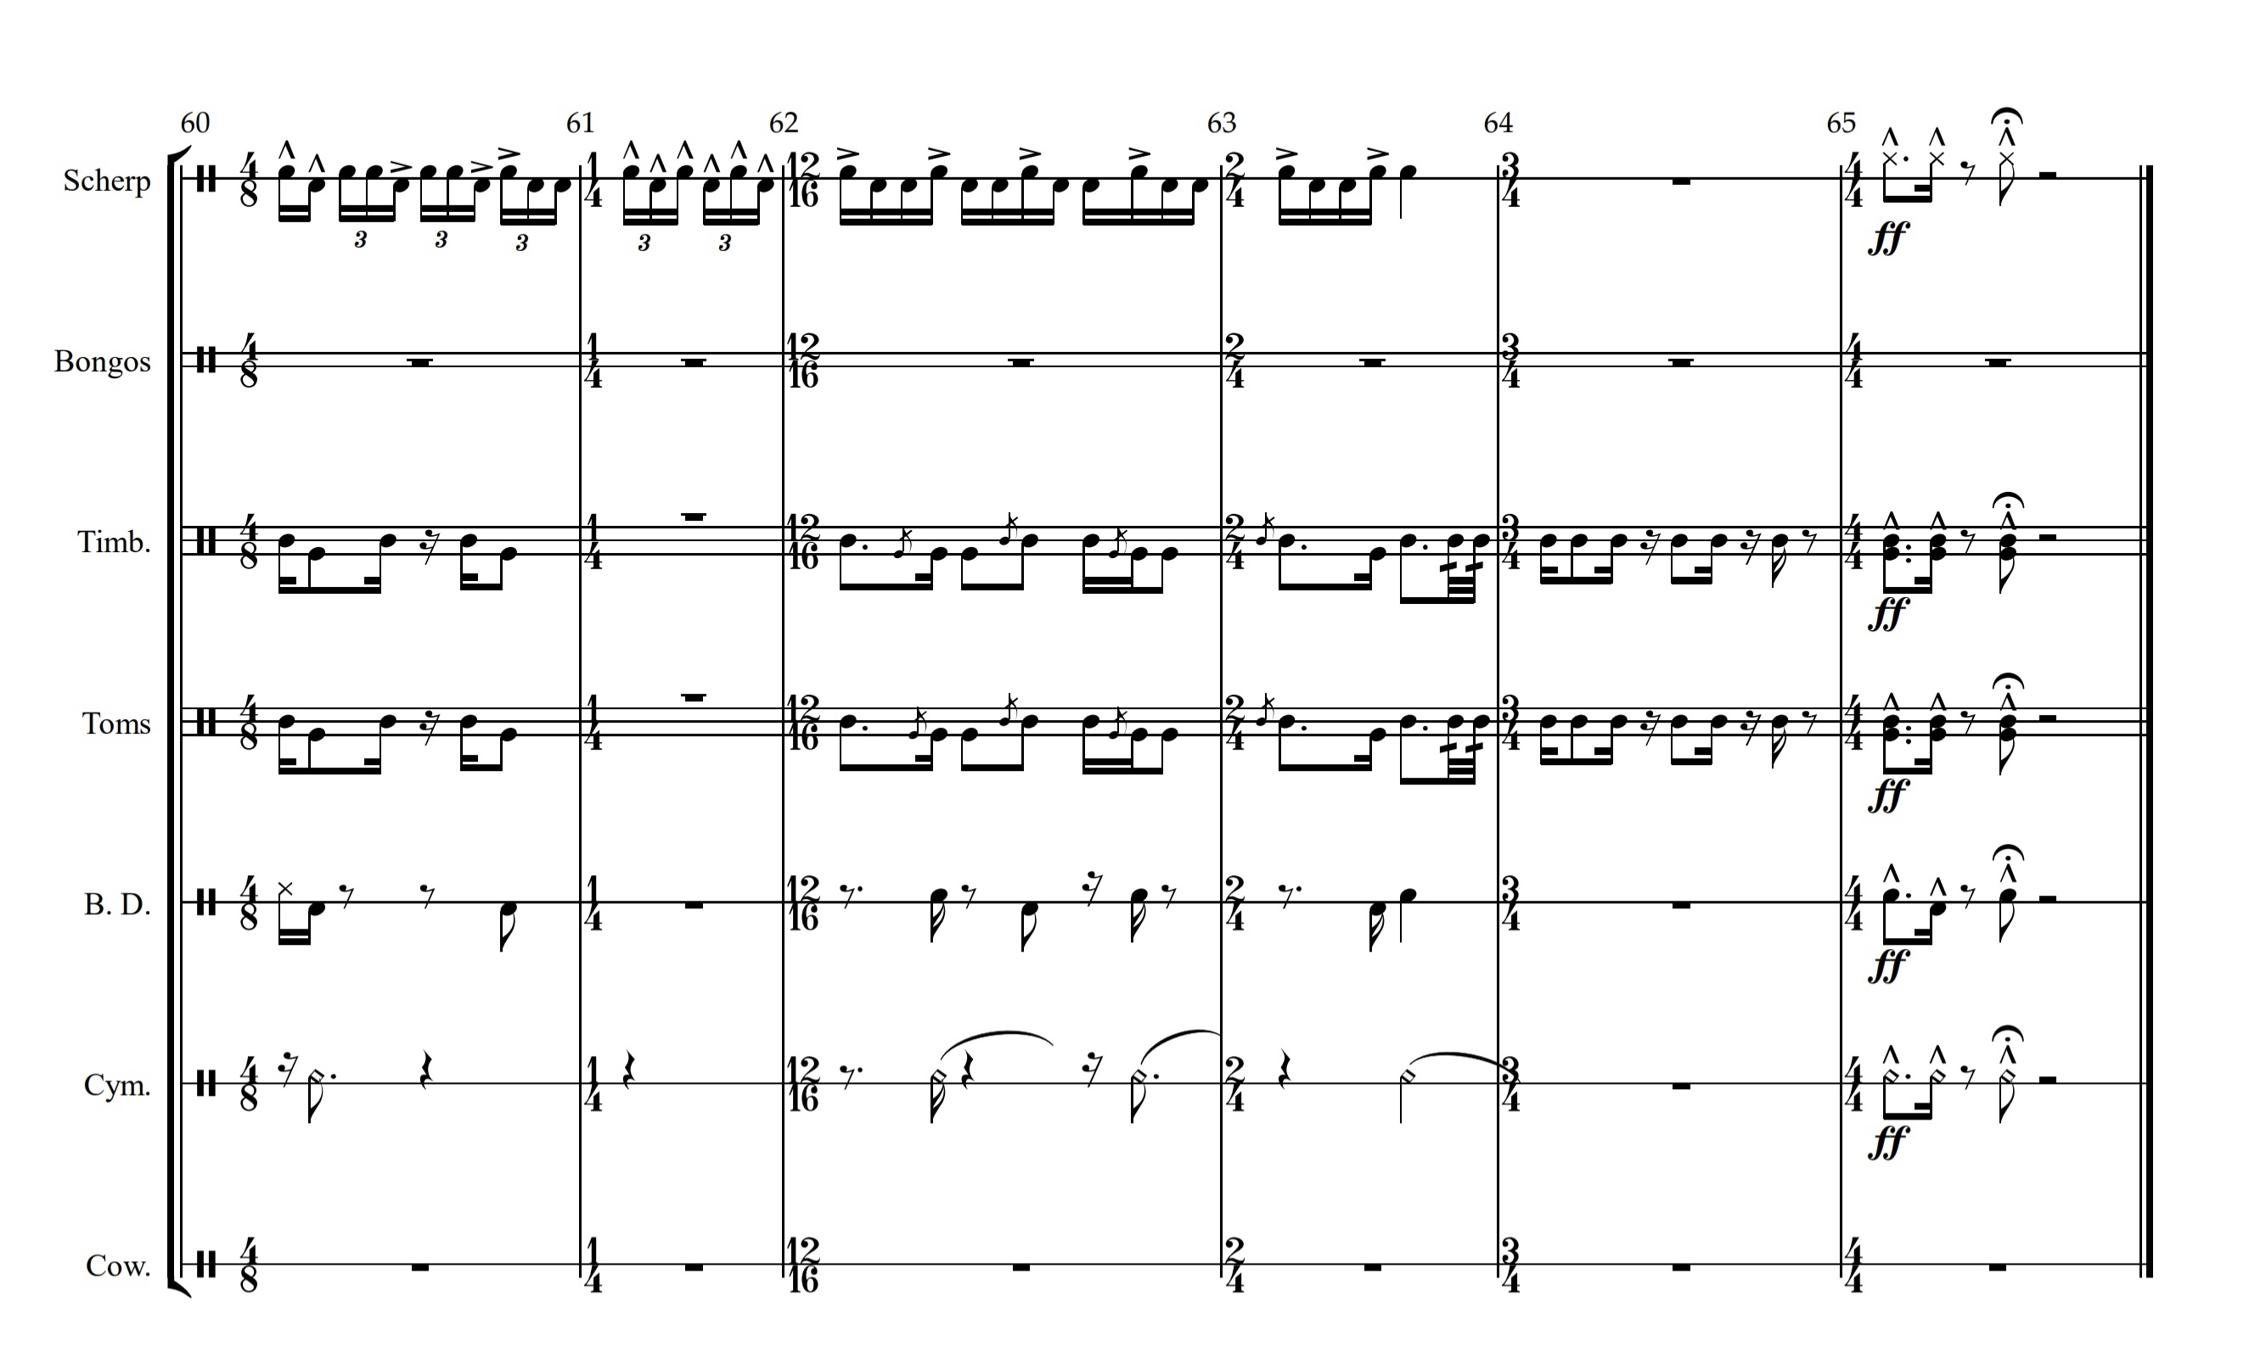
@ Where do I come from?
@ Education – Young start @ Schools & styles of music ( Latin- Classic)
@ Dutch Rich Percussion Culture and my backgroud as musician
Circle Percussion ( KODO)
Anumadutchi Percussion ( Ali N’Diaye Rose)
Absurdo ( Samba Batucada)
Drums of the World ( MIX)
“Inspiration”
Paradiso van slag
** artists like Sting, Snarky Puppy, Steve Gadd, JOJO Mayer
“Always in mind during process, can I use it for Marchingbands?”
The Composer
Write for allround?
* or commisioned ( customized)
The Percussion Factory
Projects drums of the world
Need for custom build
Can I use it elsewhere? Win-win
Compositions commisioned

Slide 6

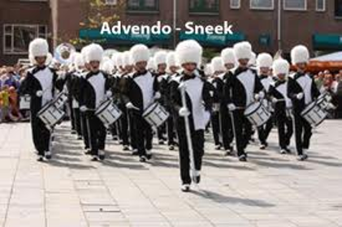

The Music
* drum solo
* or accompanied by Brass-winds
@ Parades are visible short impressions between seconds and a minute
Percussion Music needs to be short and mindblowing
Use of fast changes of tempo,phrasing and sentences. To keep attention of the public
Use of 4 bar phrasing is tastefull ( By 4/4) . Or 8 bar phrasing (by 2/4)

Slide 7
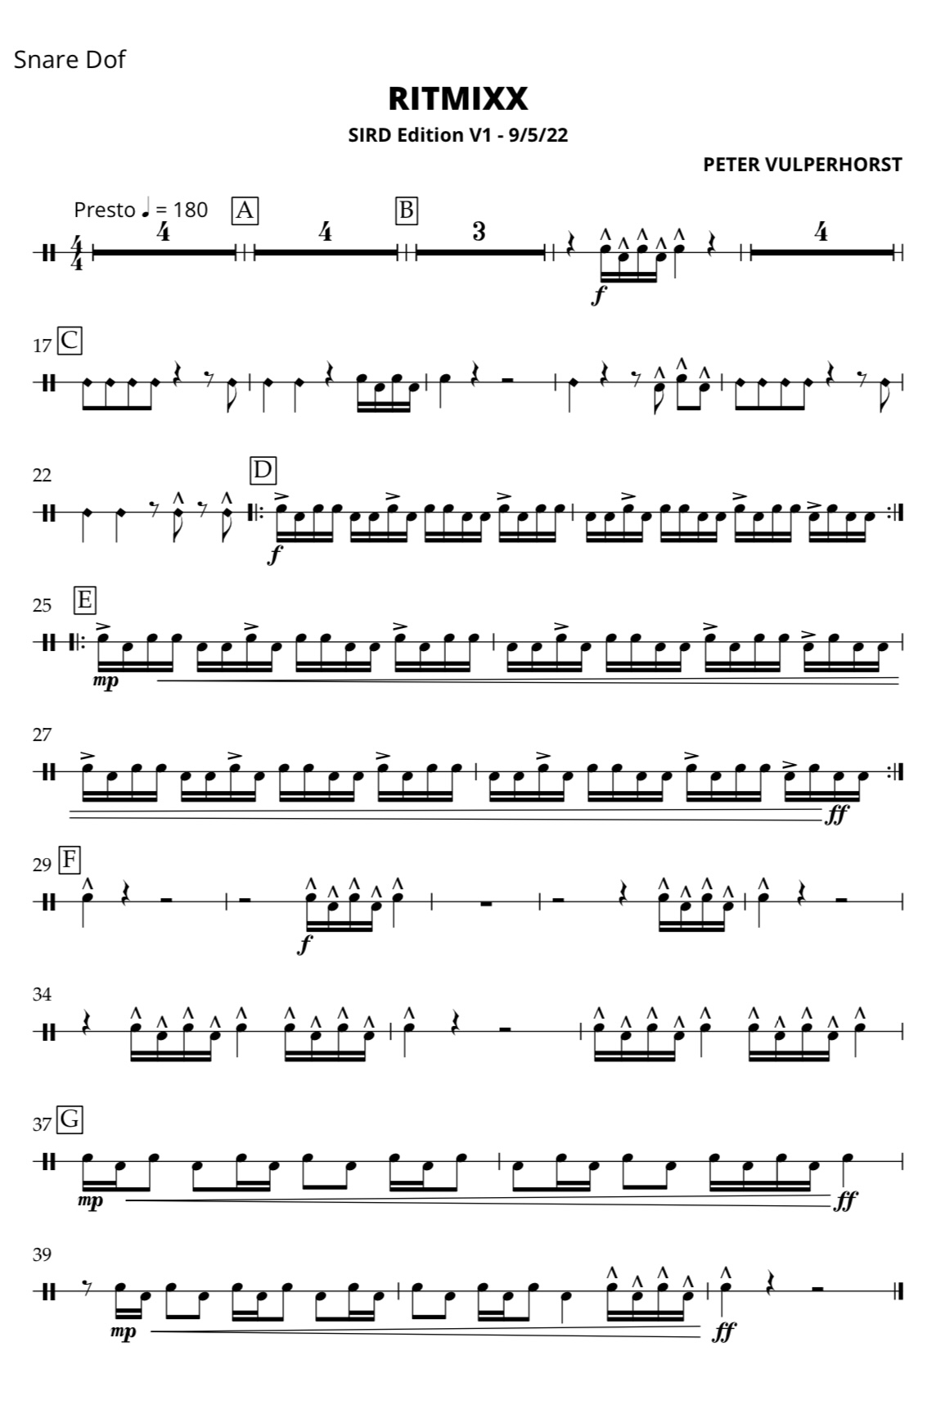
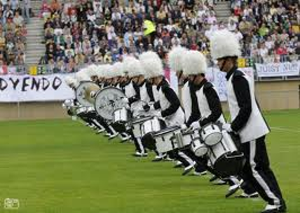
Performance
@ Ritmixx
Tempo +/- 190
Fast and Furious! Just hit and run!
To move fast from one spot to another
All about singles and paradidles
Snares On and Off, to create extra voices

Slide 8
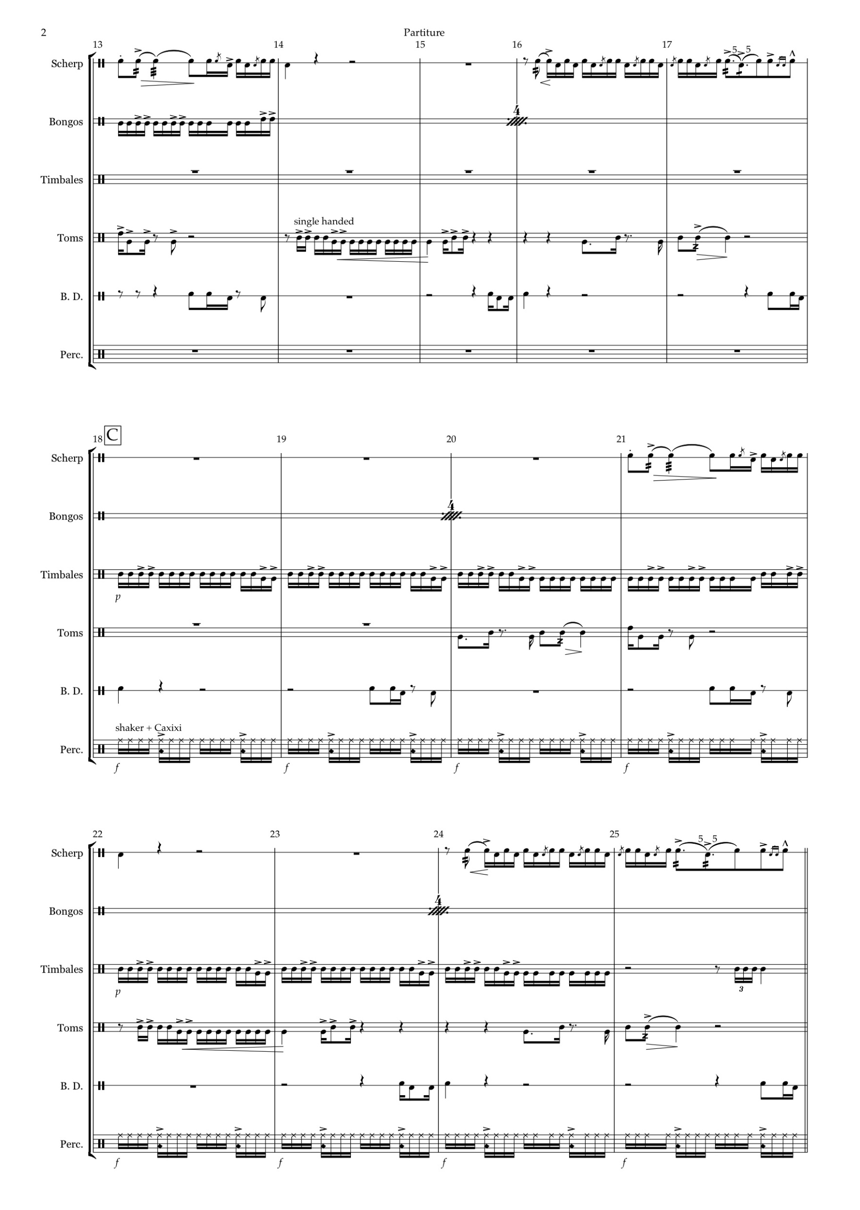
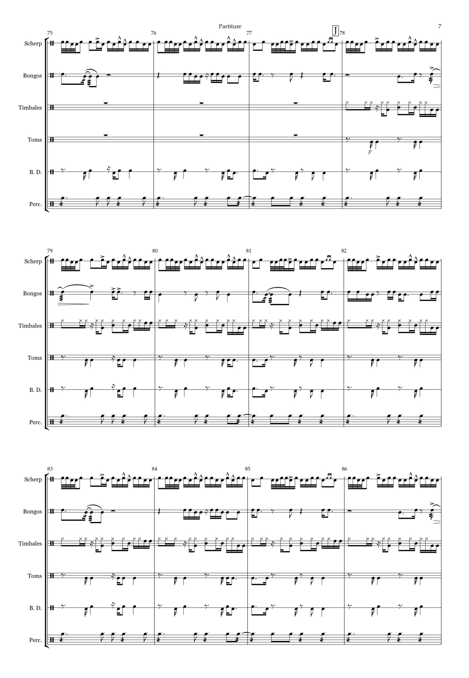

@ Always try to double the parts ( min. 2 players each part)
@ your instruments set-up in ensemble?
Composition
for me
=
Counterpoint &
Fragmental parts
Extreme example “Music Dance of the Nights”e

Slide 9
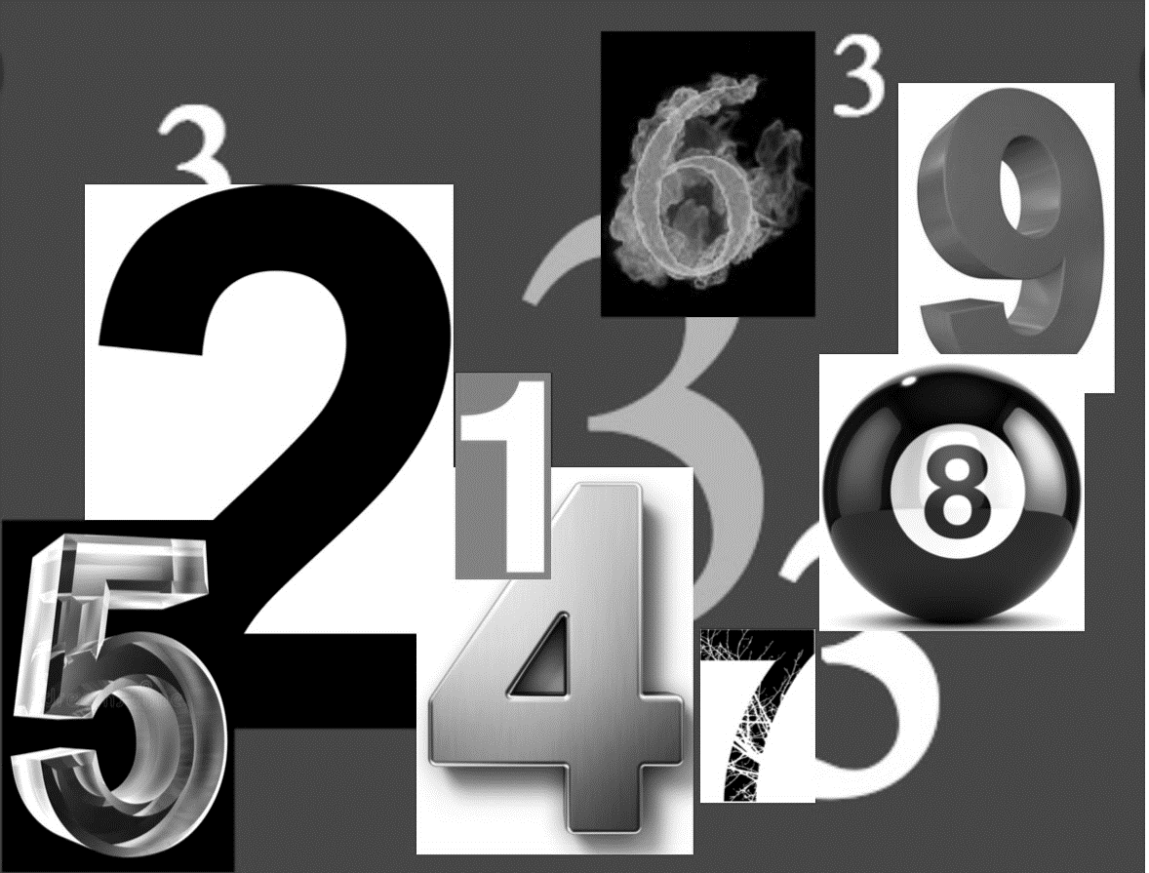
Composition
& arranging for
Rudimental Marching-Showband style ( Latin influence)
“ I “ Never write only for one particular purpose.. Show-Parade etc.
@ Always meant to be ” memorized ”
Music and parts needs to be recognizable
@Flexibel to use in any circumstances at that moment
@ Always try to double the parts ( min. 2 players each part)
@ your instruments set-up in ensemble?

Slide 10
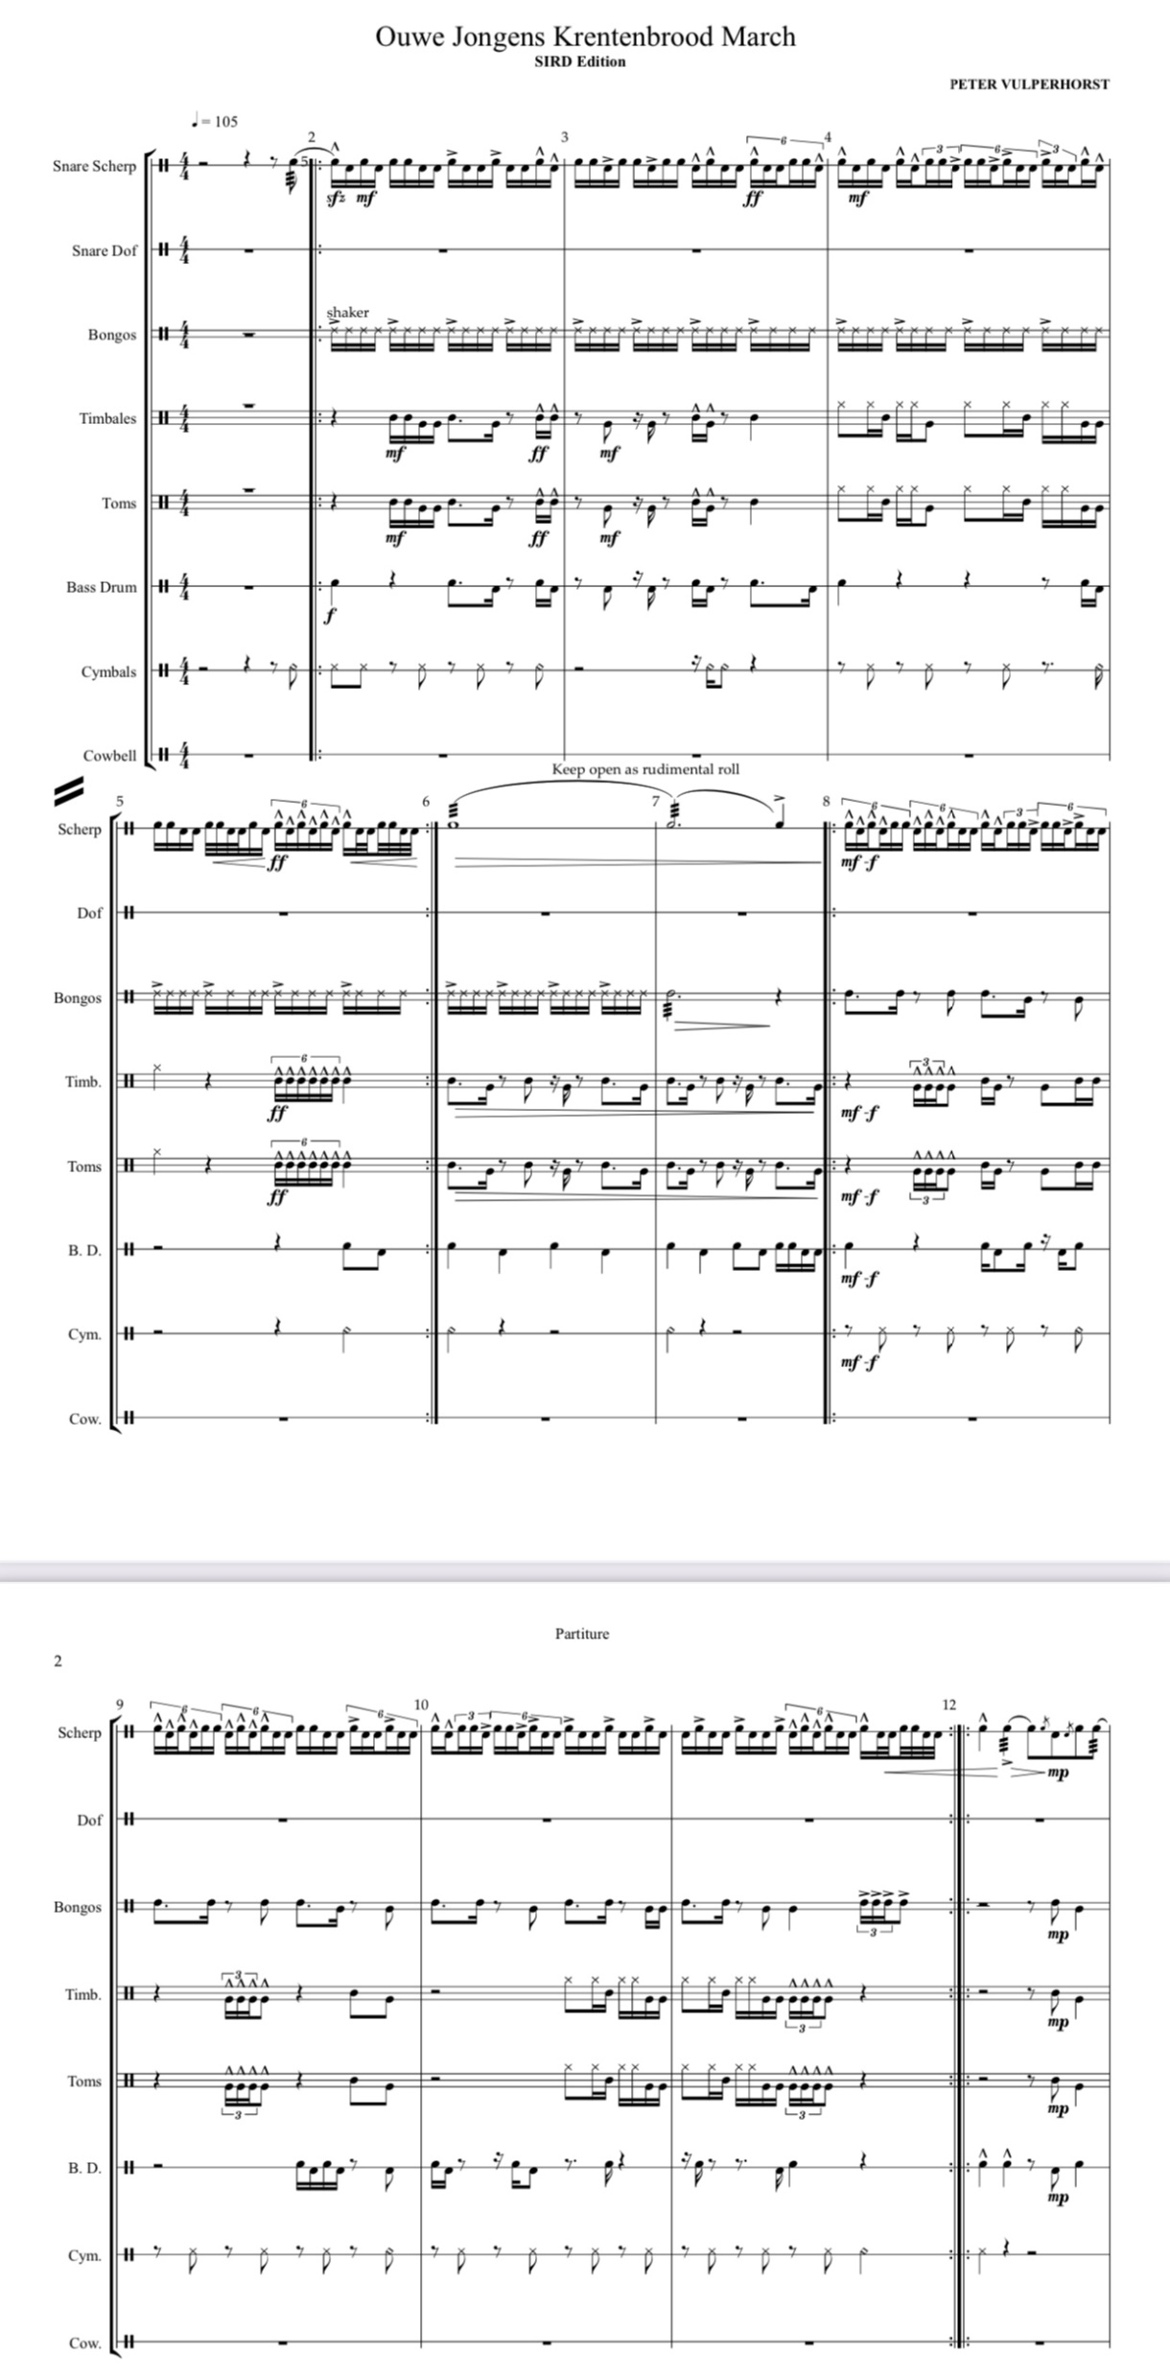
Composition
= for me
Counterpoint….
@ Ouwe jongens Krentenbrood March
Beer, BBQ and Best friends
Traditional Rudimental figures in one march
Far most important figure I use is sextuplets
Most flexibel to use in different tempo’s
Accents posibilities
P1→

Slide 11
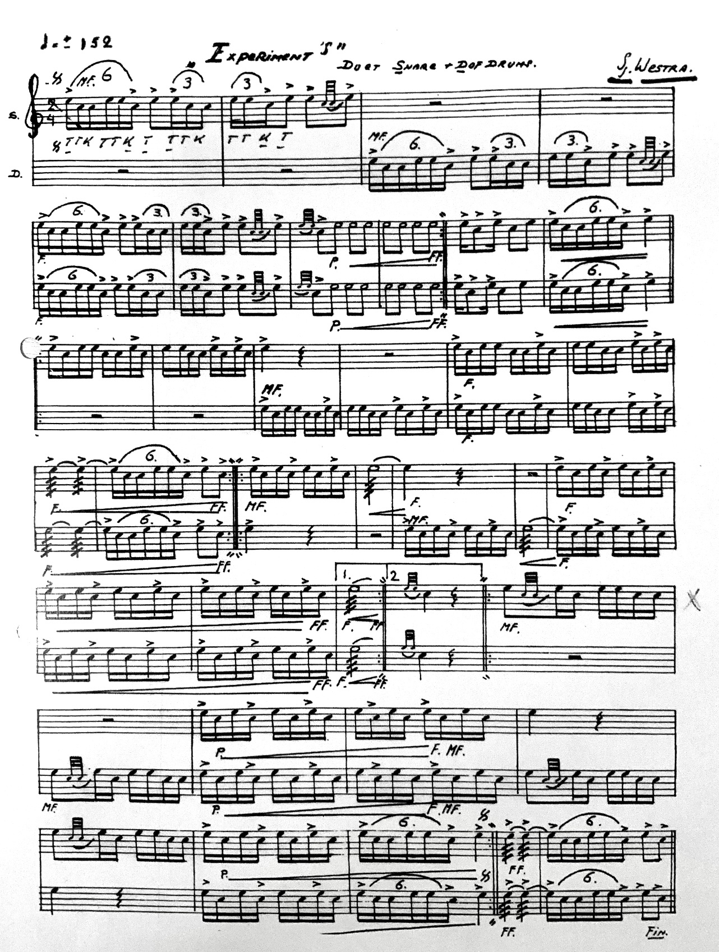
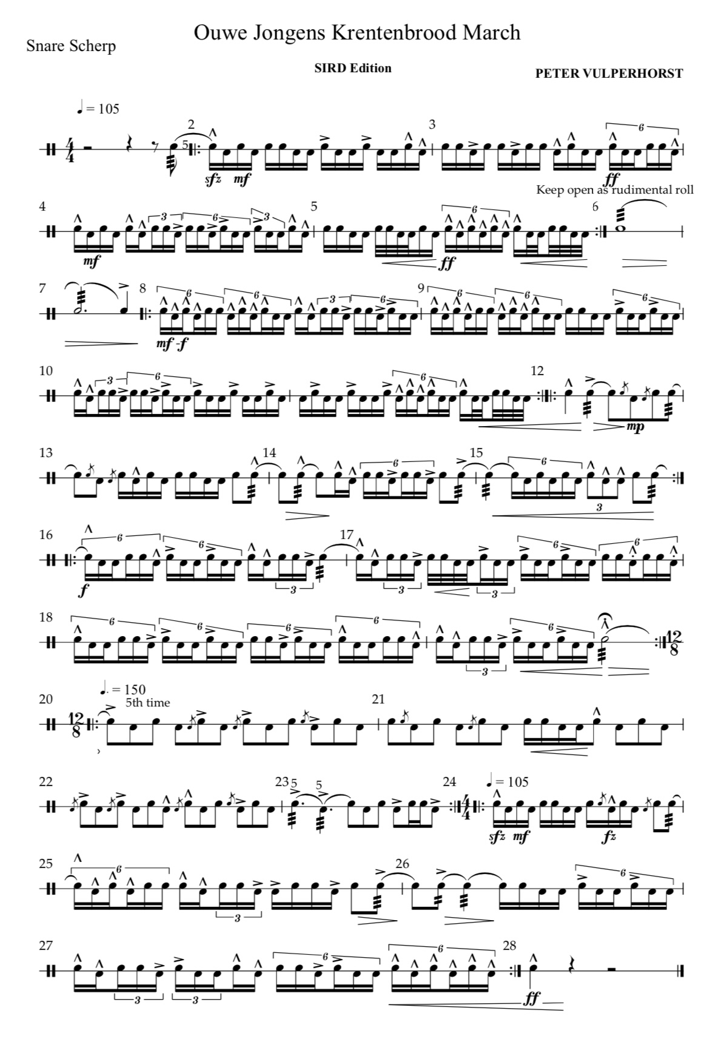
The Composition
@ Ouwe jongens Krentenbrood March
Combinatons between singles and diddles
Para-Diddles combinations
Old vs New
P2→

Slide 12
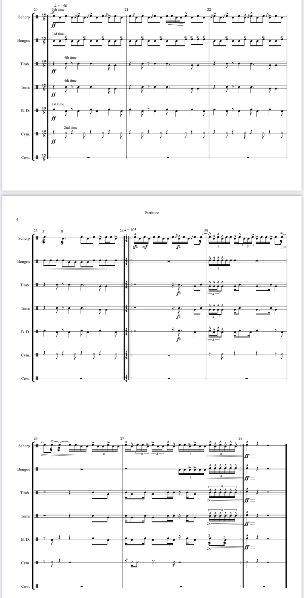
@ Ouwe jongens Krentenbrood March
12/8 One of those most favorite..
Multiple endless rhythm variations
Multiple walking
P1

Slide 13
Performance
@ Ouwe jongens Krentenbrood March
12/8 One of those most favorite..
more to come…… Next Page…

Slide 14
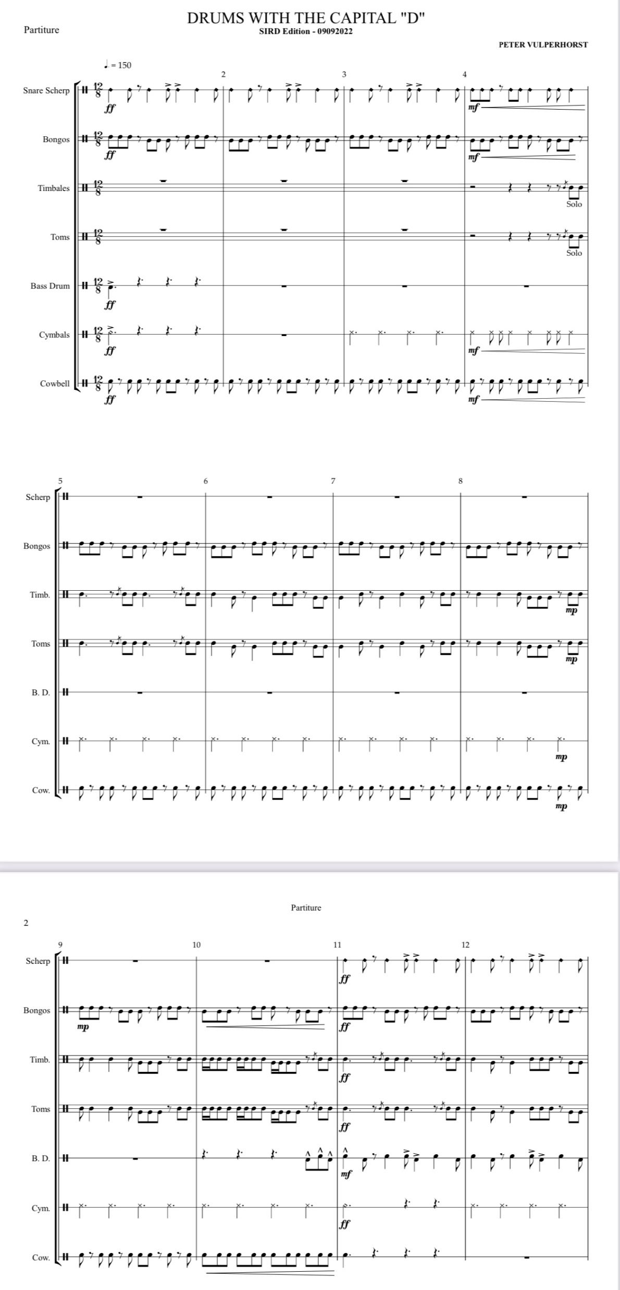
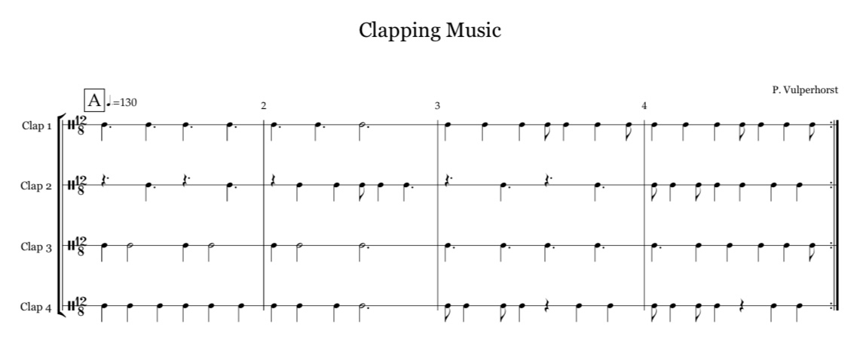
@ Drums with the Capital “D”
Tempo 150
12/8
(Fan of the 12/8 ( or 6/8))
Mucho Grande
P1

Slide 15
Performance
@ Drums with the Capital “D”

Slide 16


Look up at the sky and remember your dearest..
Arrangement made for PASIC 2014
Where all rudimental paterns come together
The End

